Slide 1

Healthy and strong
happy family

Slide 2


How to be healthy and strong?
strong
healthy
Healthy and strong is important.Now let me tell you how to keep strong and healthy.

Slide 3

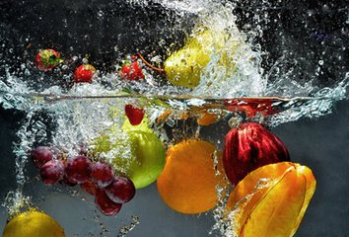
First
The first way is always have breakfast . And eat good food for your breakfast. Look at this picture.
fruit
vegetables

Slide 4



second
Then you must do exercise everyday . Then you will be grow stronger and stronger. This are some exercise picture.
running
Playing
football
swimming

Slide 5


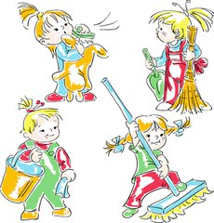
third
You must work hard at school , at home and at sport.
At home do the housework
At school do the homework
At sport do exercises

Slide 6
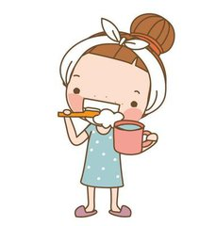

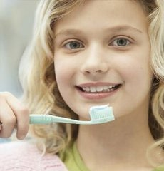
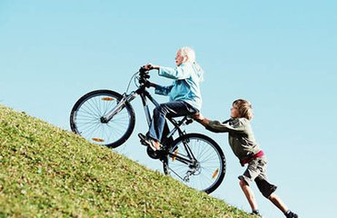
At last
And at last you need good living habits.
Brush your teeth
Go to bed early and get up early
be ready to help others

Slide 7
And good health to you
Thanks a lot

